Slide 1
custom domains

Slide 2
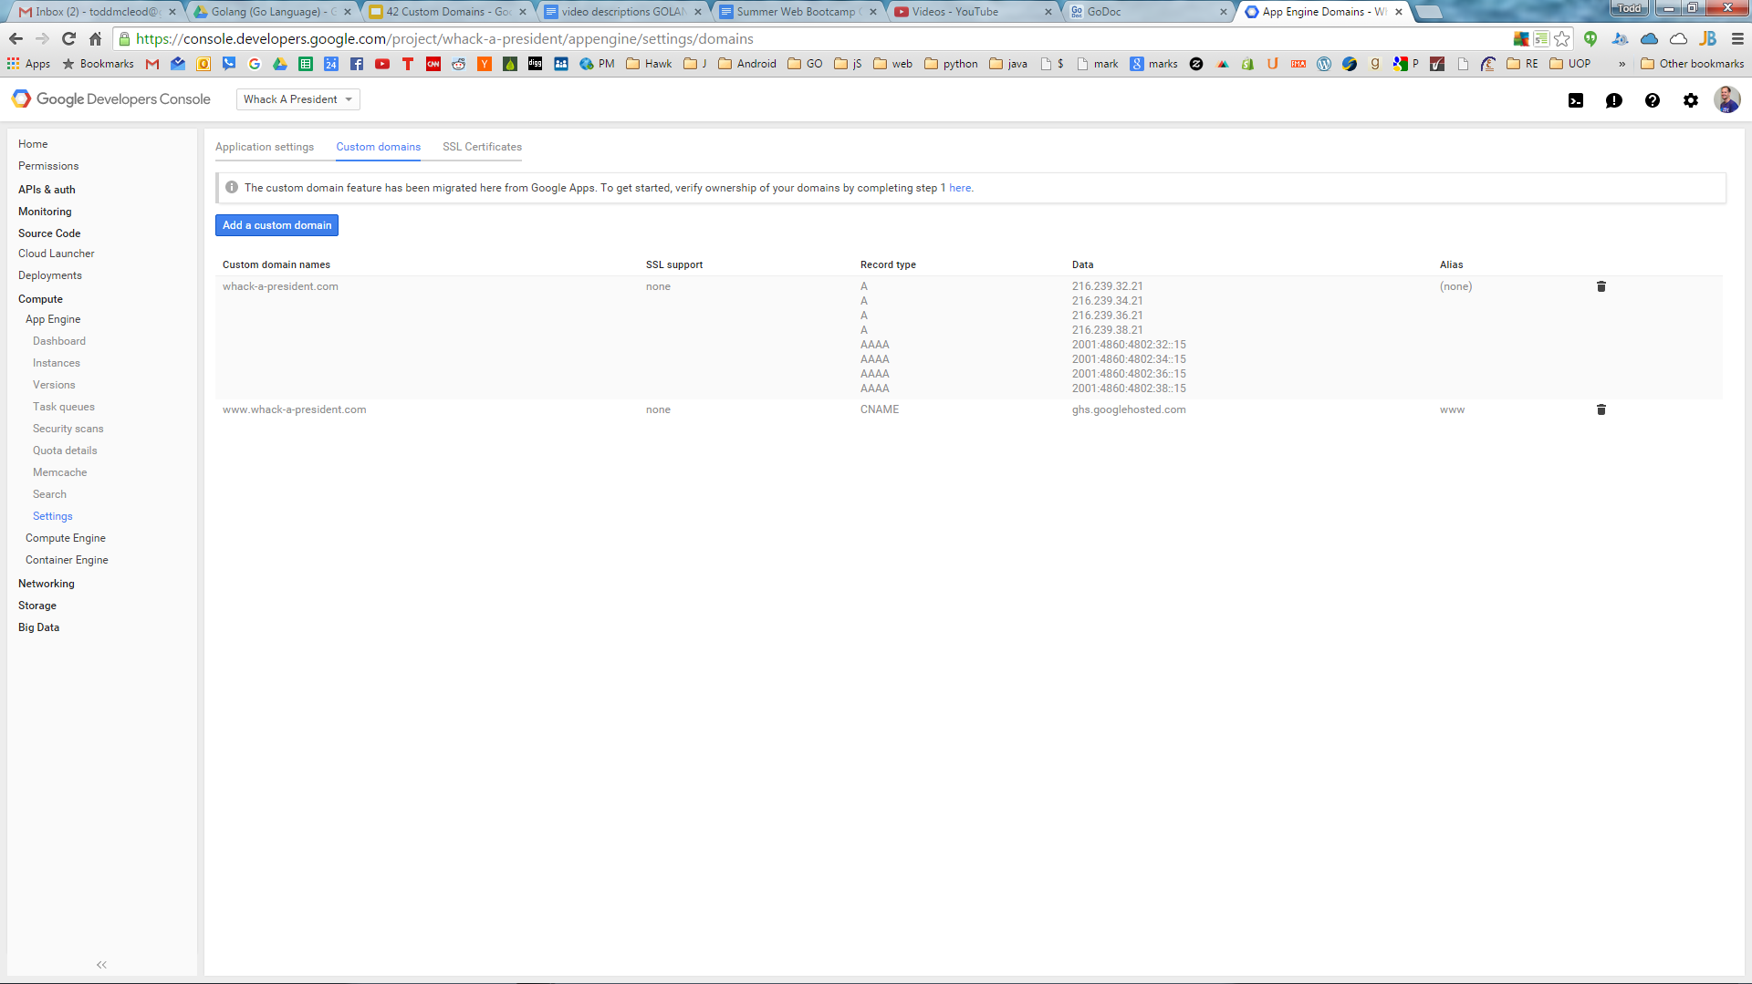

Slide 3
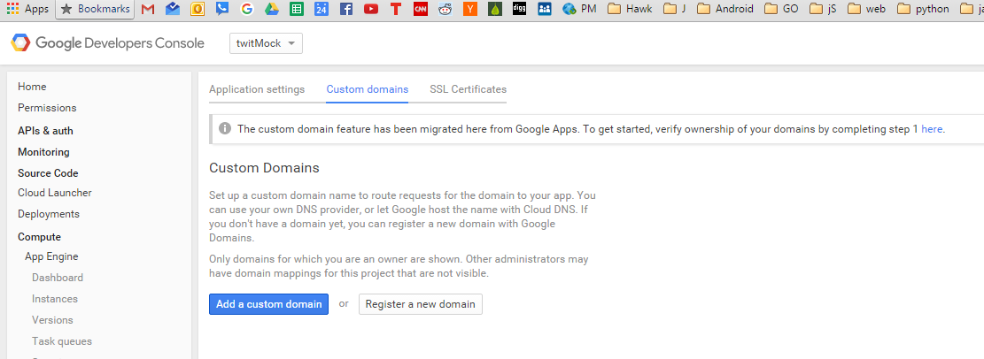

Slide 4
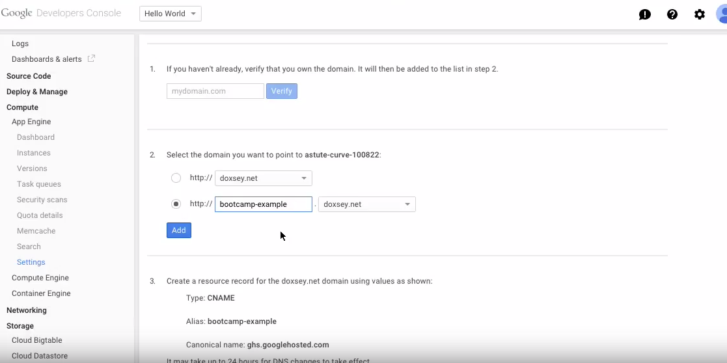

Slide 6
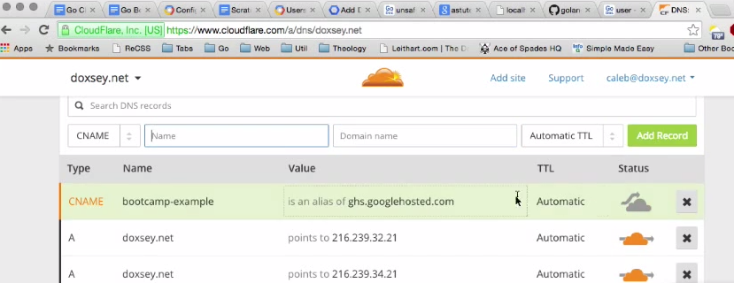

Slide 7
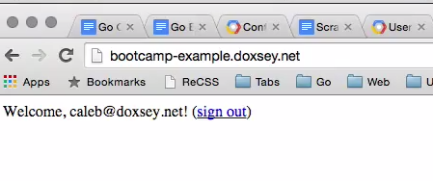

Slide 8
CNAME vs A
https://www.youtube.com/watch?v=WqhgGpv4cKY

Slide 9
CNAME RECORD
www.google.com
mail.google.com
docs.google.com
maps.google.com
maps to another domain
google.com
A RECORD
google.com
maps to an IP address
74.125.224.117

